Slide 1
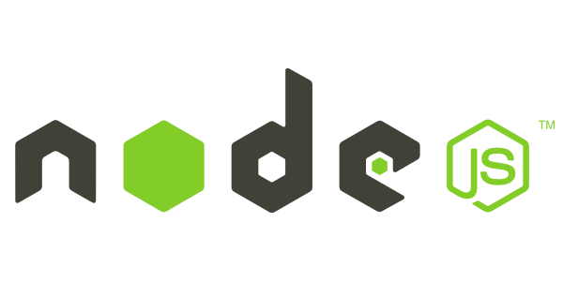

Web Dev 5
Back-End Web Dev with Node
tinkercademy.com

Slide 2
Recap
HTML
CSS
JavaScript
jQuery

Slide 3

Today
What is a server?
Introduction to Node.js
Running Node at home
Running Node on Glitch
HTTP requests
The Express framework
Make a Dad Joke Generator
JSONs
APIs
Continue making a DJG

Slide 4

What is a server?
It’s like ordering food at a restaurant.
You tell the waiter what you want, and he/she brings it to you.
Tell the server the pages you want to see (url), and it brings the HTML to your browser!
Notes:
Of course it’s more complex than this, there’s the whole field of networking: https://en.wikipedia.org/wiki/OSI_model
We’re only going to be focusing on the top 2-3 layers (Application layer, Presentation layer, Session layer), and much of it is abstracted away, really.
https://www.ntu.edu.sg/home/ehchua/programming/webprogramming/HTTP_Basics.html

Slide 5
What is a server?
The server and the stack
LAMP (Linux, Apache, mySQL, PHP)
MEAN (MongoDB, Express, Angular, Node.js)
ASP.net
Web Hosting (AWS, DigitalOcean, Raspberry Pi)
Notes:
A server sits there, waiting (and listening) for other computers to talk to.
The server often does not have a monitor, is not in the same country as you, and has an IP address that is pointed to by a DNS server.
Node.js is a server written in JavaScript. There are several other languages you can use.

Slide 6
What is Node?
A server-side run-time environment that runs on JavaScript
Aim was to create real-time websites with push capabilities
Allows for JavaScript everywhere (front and back end)
Supposedly great for concurrent connections — speed and scalability
Notes:
What is scalability? http://highscalability.com/google-architecture

Slide 7
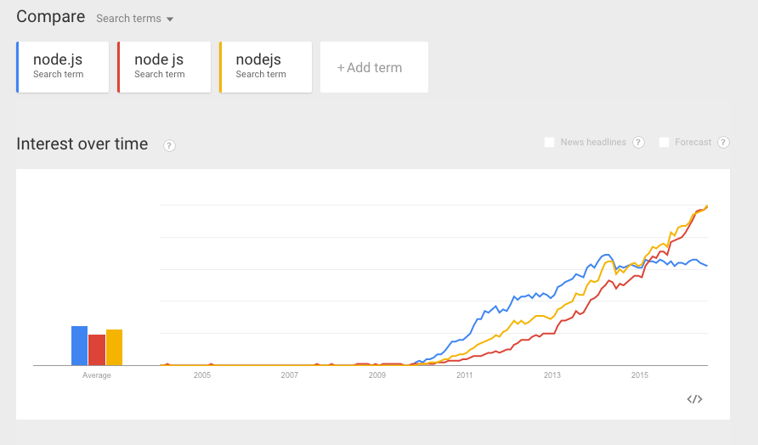
The Node.js bandwagon

Slide 8
Running Node
Try at home: get Node working on your home computer— https://medium.com/@adnanrahic/hello-world-app-with-node-js-and-express-c1eb7cfa8a30

Slide 9
Node Server
Run locally
Start Git Shell or PowerShell
Run in the Cloud
Nitrous
Amazon EC2
Cloud9
Glitch
Running locally…
In Windows, run PowerShell
cd D:/
mkdir node/<yourname> [don’t use any spaces]
Open the folder in Atom/Notepad++/Editor of your choice
Create an index.js file
Notes:
Setup

Slide 10
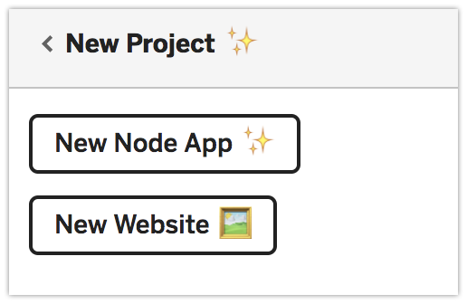
We’ll use Glitch
Go to glitch.com, sign up, top left corner, or New Project:

Slide 11
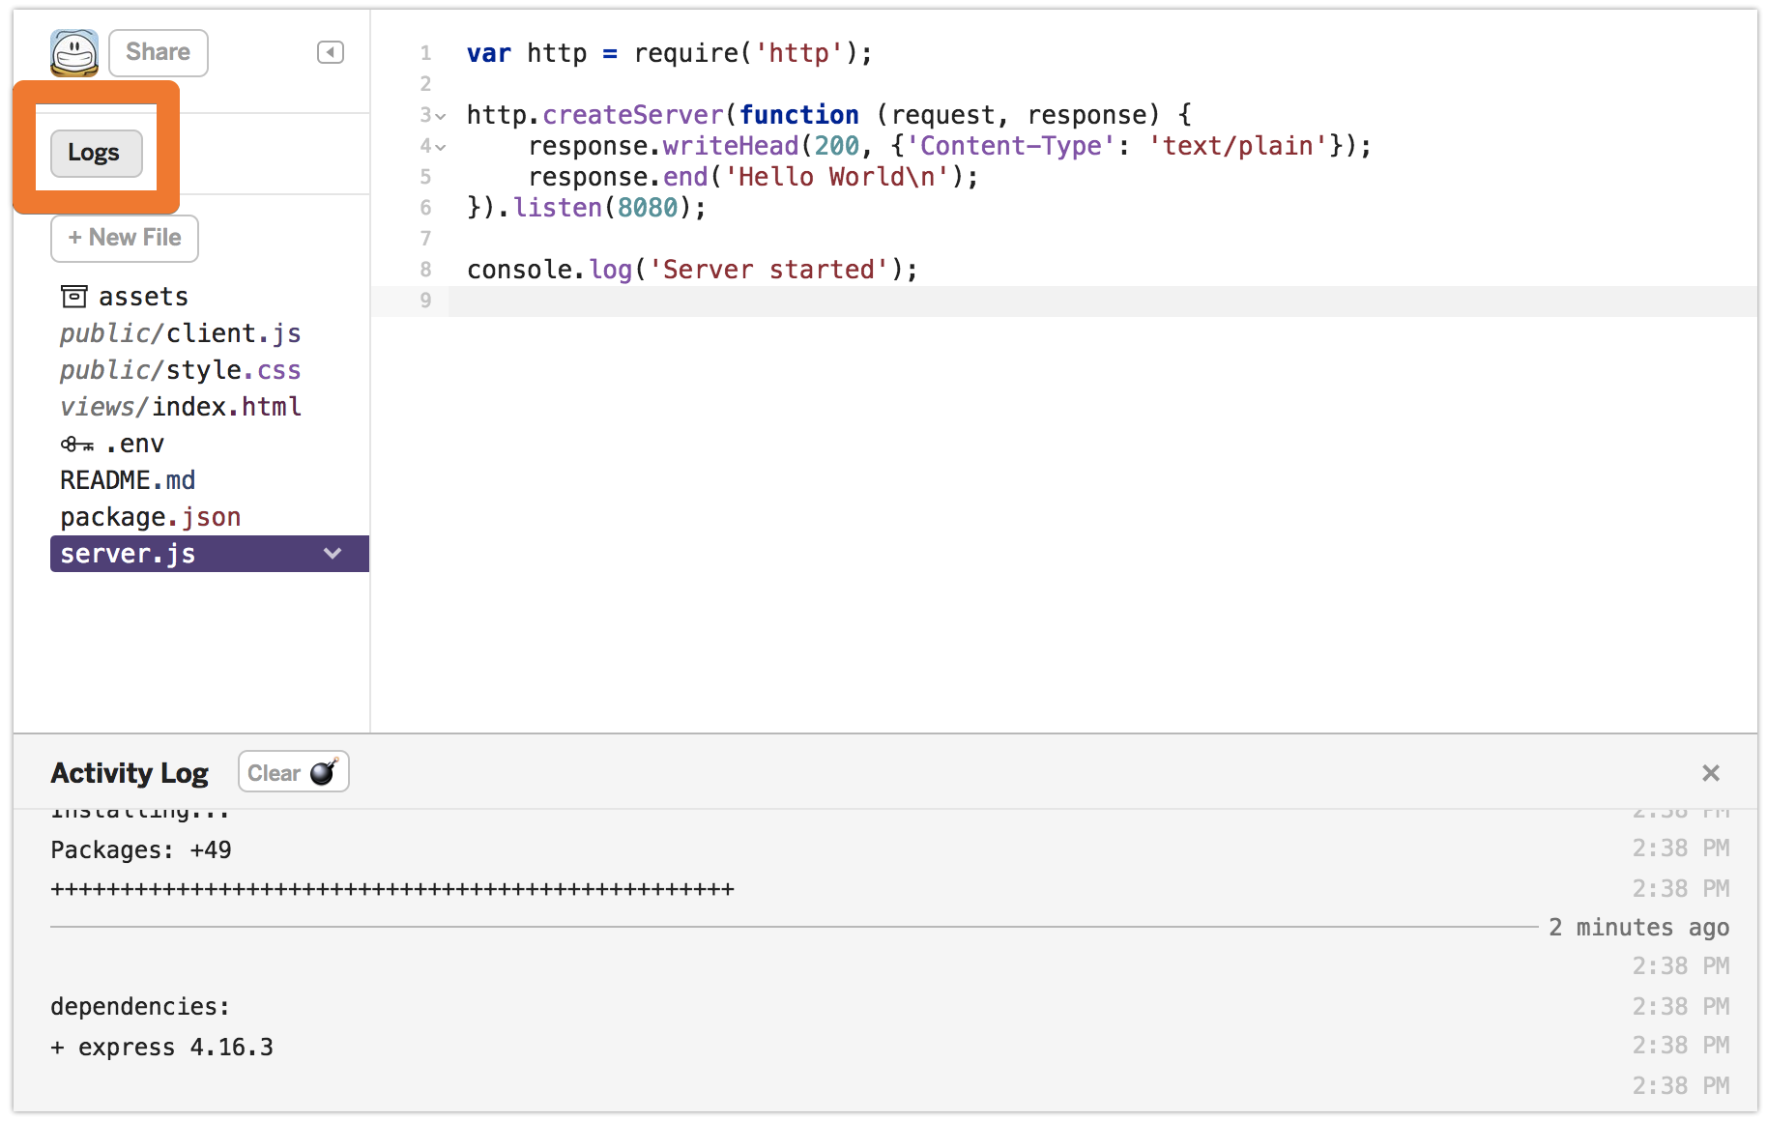
console.log is in Logs

Slide 12
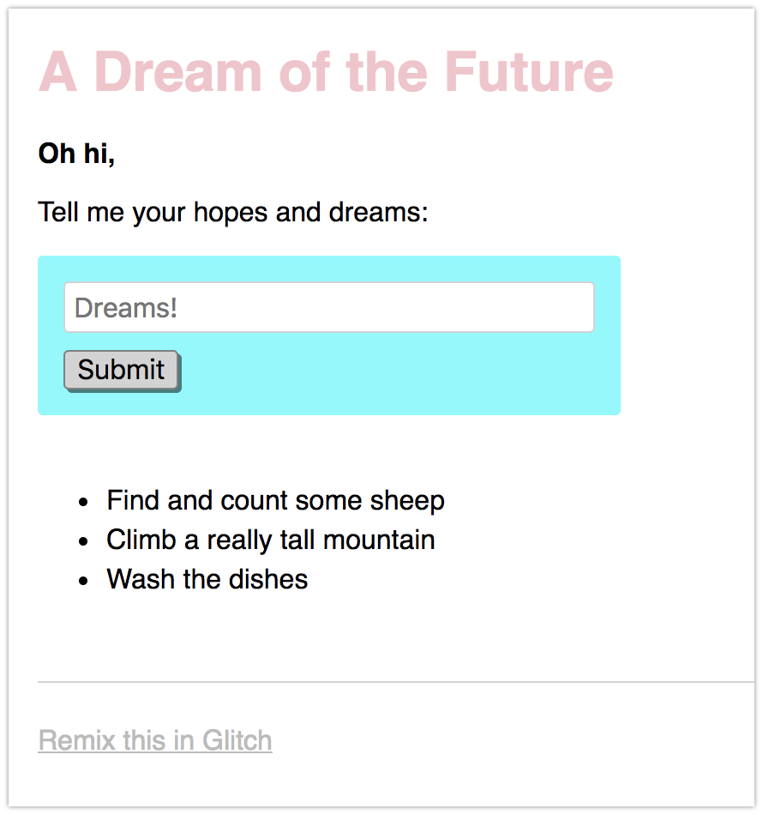
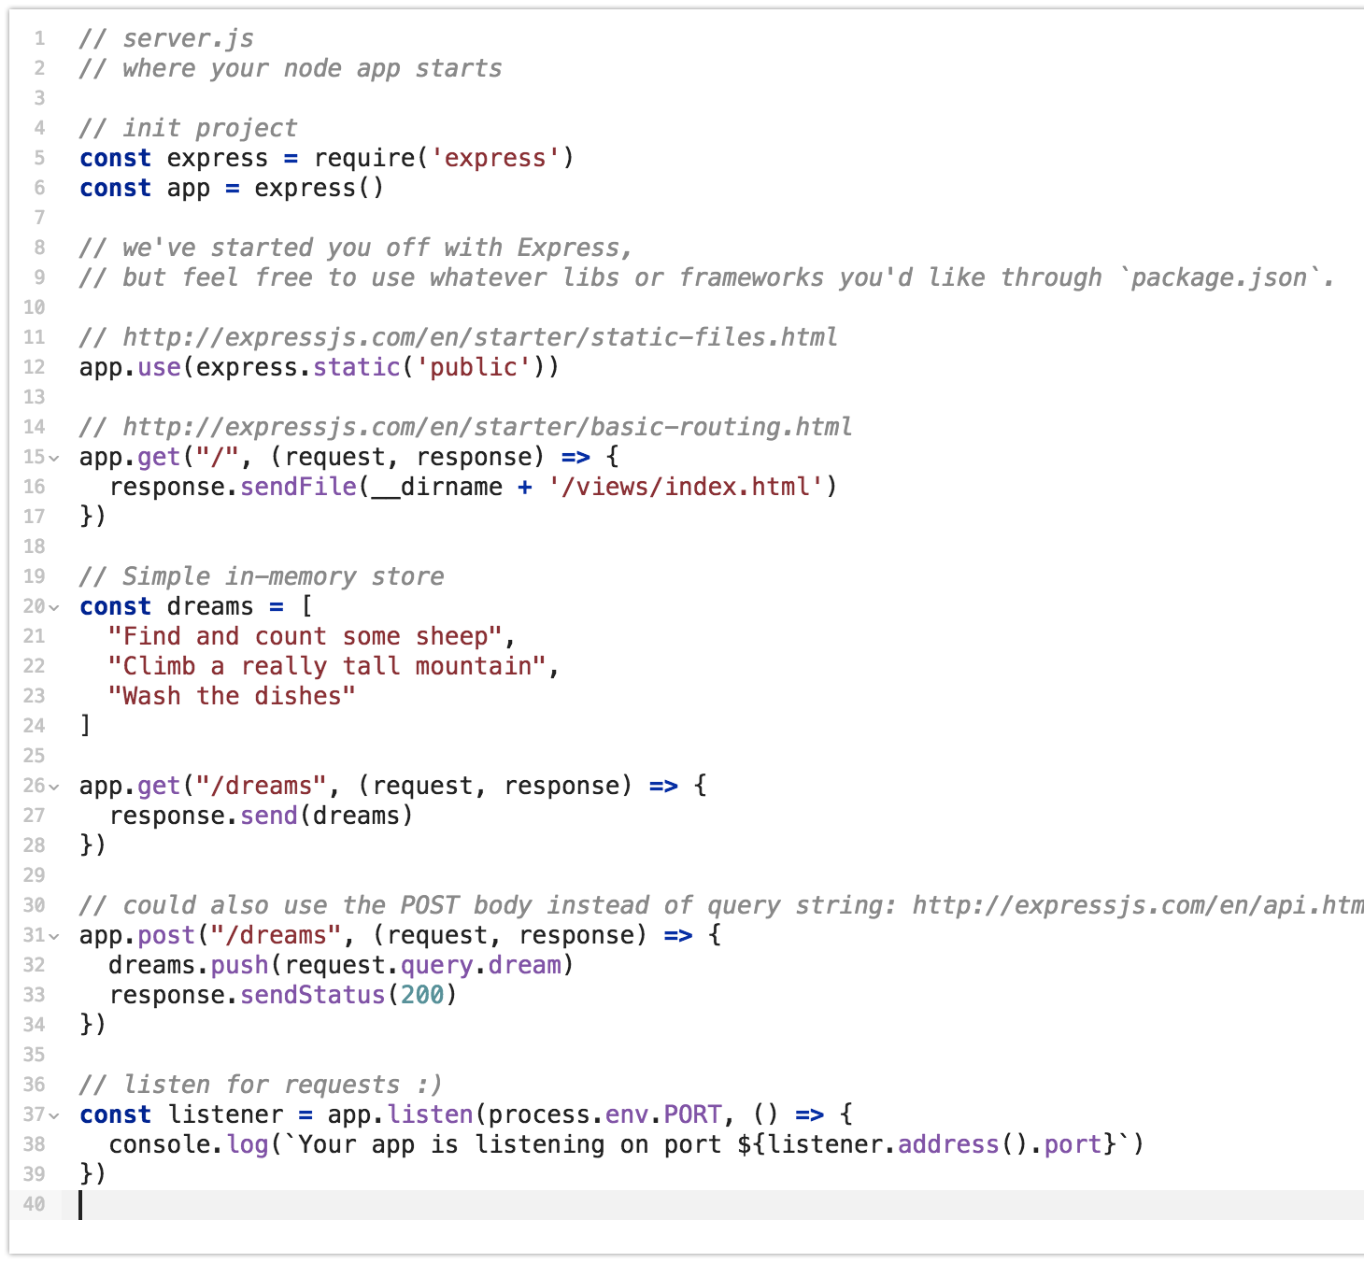
Built-in app you can explore

Slide 13
Let’s start from scratch
DELETE EVERYTHING except the first two and last two lines of code (see next slide)

Slide 14
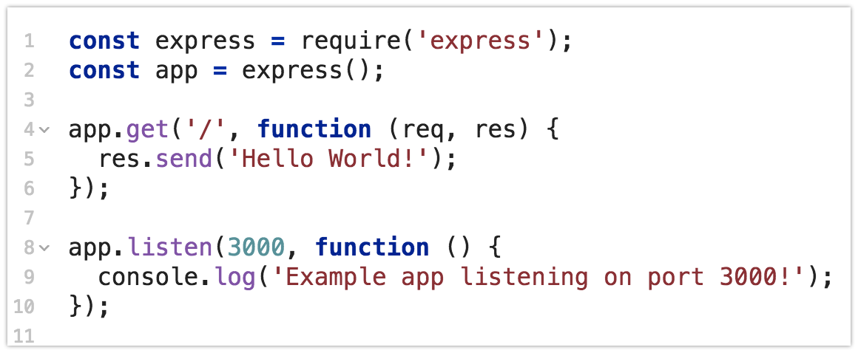
Try: HTTP responses
Add in a few lines in between (line 4 to 6, in this case)
Notes:
Feel free to try other functions!

Slide 15
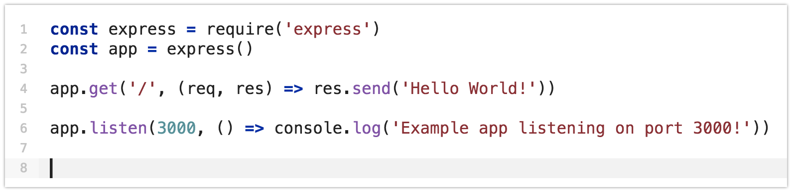
Try: HTTP responses
You may see functions defined as fat arrows “=>” — we’ll explain more of these next time, or you can google for ES6 arrows. This is how your JS might also look:
Notes:
Feel free to try other functions!

Slide 16
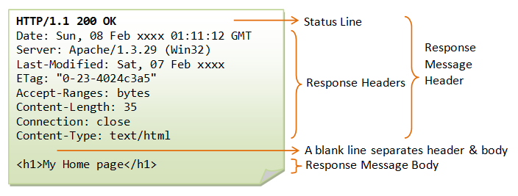
HTTP Response

Slide 17
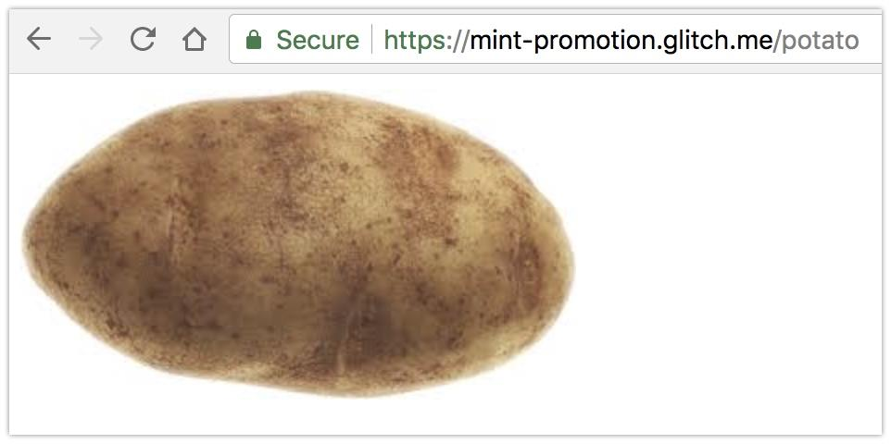
Exercise: Routes
Right now, if you go to <your URL>/potato, it’ll give you an error.
Your website cannot serve a potato. This is sad.
Can you add some routing logic to your web server, to give a picture of a potato? You can hotlink to any Google Image of a potato.

Slide 18
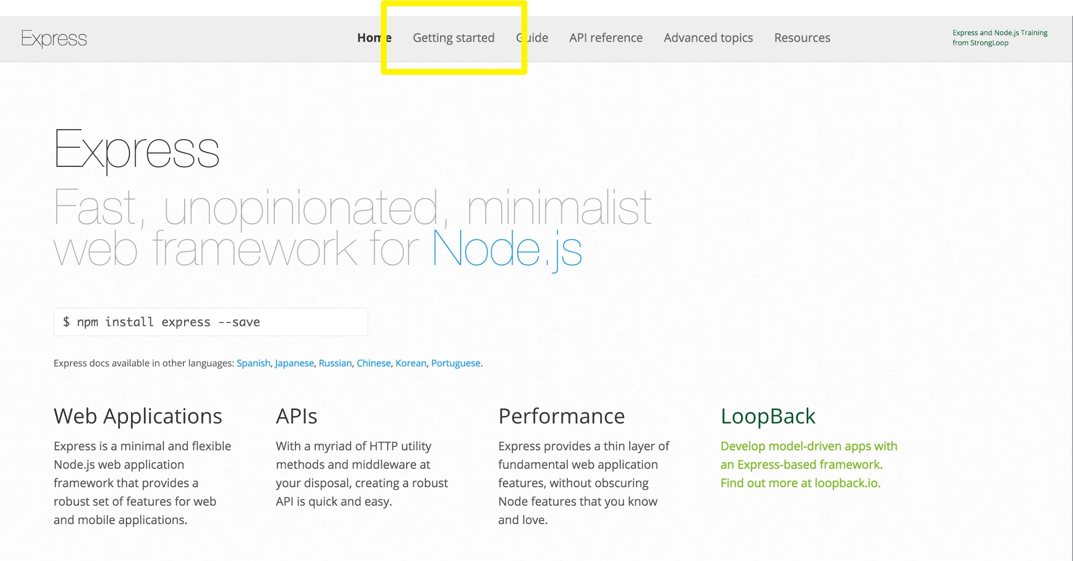
Express
We normally use NPM to install Express…
But Glitch has it installed
Notes:
npm init
npm install express --save

Slide 19
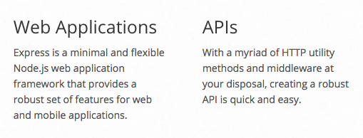
Why Express?
Express is a framework. Frameworks help to reduce the amount of code you need to write by having a lot of routine functionality already written for you.

Slide 20

Exercise:
Dad Jokes

Slide 21
Start a new app, DELETE ALMOST EVERYTHING:

Slide 22
Getting Started with our Joke “API”
Copy in the jokes array from this Gist: https://gist.github.com/yjsoon/7488b74b5f95b1c7b99e1cea81f13155
Add the following route:
var jokes= [...copy and paste]
app.route("/jokes").get(function(req,res,next){
res.send(jokes[Math.floor(Math.random()*jokes.length)]);
});
Add /jokes to the end of your URL and access the page
Refresh for more hilarity!
And figure out how the random array index works

Slide 23
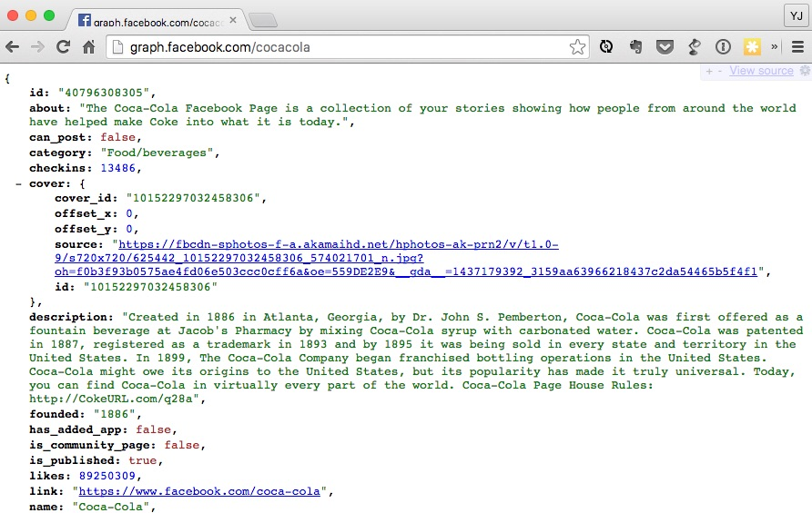
Aside 1: JSON

Slide 24
Objects (Data structure)
Objects are used to organise data
Usually contain levels of hierarchy
An example:
Customer
Name: Akmal
Surname: Abd Rahman
Class: 1A
Address:
Street: Fort Road
Unit: 35
Postcode: 123456

Slide 25
JSON (JavaScript Object Notation)
{
“Key1”: value1,
“Key2”: value2,
“Key3”:
{
“Key4”: value4,
“Key5”: value5
}
}
Notes:
Object literal

Slide 26
JSON (JavaScript Object Notation)
{
name: “Akmal”,
surname: “Abd Rahman”,
class: “1A”
address:
{
street: “Fort Road”,
unit: 35,
postcode: 123456
}
}
Notes:
Objects can contain more objects. Objects can also contain arrays and functions…

Slide 27
JSON in practice
var object = {
name: “lucky object”,
number: “777”
}
console.log(object.name);
console.log(object.number);
Access the object’s attributes using the dot notation.
Notes:
Try these in the Javascript Console!

Slide 28
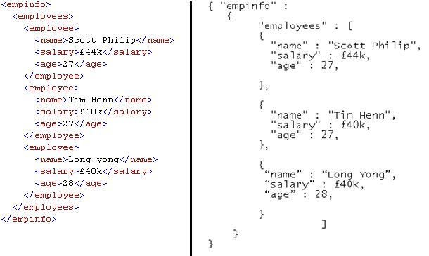
XML vs. JSON
Notes:
JSON uses less bytes to store/transmit than XML because it doesn’t have a closing tag.

Slide 29
Refresher: JavaScript Arrays
Arrays are “lists”:
[item1, item2, item3]
Usually used for storing a list of values in some sort of sequence, where the sequence is important

Slide 30
JavaScript Arrays
var array = [“item1”, 2, 3+3]
console.log(array[0]);
console.log(array[1]);
console.log(array[2]);
Access the array’s values using the bracket notation. Observe that arrays start at 0, 1, 2 … and so on. This is known as zero based numbering, where we access the first element by calling the [0] index.
Notes:
Try these in the Javascript Console!

Slide 31
Objects and Arrays together
var jokes=[
{setup:"Our wedding was so beautiful,",punchline:"even the cake was in tiers"},
{setup:"I'm reading a book on the history of glue",punchline:"I just can't seem to put it down"}
]
Is jokes an array or an object?
console.log(jokes[0]); // gives us the whole object
console.log(jokes[0].setup); // gives us just the setup
console.log(jokes[1].punchline); // just the punchline
Notes:
Try these in the Javascript Console!

Slide 32
Back to Dadjokes
app.route("/jokes").get(function(req,res,next){
res.send(jokes[Math.floor(Math.random()*jokes.length)]);
});
Try in the JavaScript console:
Math.random();
Math.random()*15;
Math.floor(1.6);
Math.floor(0.3);
Math.floor(Math.random()*20); // try this a few times
What we are really doing is accessing a random index of the array, i.e.:
jokes[1]
jokes[2]
jokes[randomInteger]
Notes:
Try these in the Javascript Console!

Slide 33

Aside 2: APIs
Notes:
Application programming interface (http://sproutsocial.com/insights/what-is-an-api/)

Slide 34
Amazon
A mandate from Jeff Bezos to all Amazon employees, 2002:
1) All teams will henceforth expose their data and functionality through service interfaces.
2) Teams must communicate with each other through these interfaces.
3) There will be no other form of interprocess communication allowed: no direct linking, no direct reads of another team's data store, no shared-memory model, no back-doors whatsoever. The only communication allowed is via service interface calls over the network.

Slide 35
4) It doesn't matter what technology they use. HTTP, Corba, Pubsub, custom protocols -- doesn't matter. Bezos doesn't care.
5) All service interfaces, without exception, must be designed from the ground up to be externalizable. That is to say, the team must plan and design to be able to expose the interface to developers in the outside world. No exceptions.
6) Anyone who doesn't do this will be fired.

Slide 36
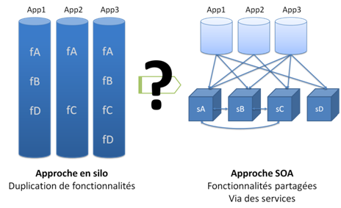
Software silos vs. SOA
Service-Oriented Architecture:
No service can access or change another’s data
Can only make requests via an Application Programming Interface (API)
Sorry for the french this is all I could find
Notes:
APIs force programmers to conform to a set of specifications when making requests.

Slide 37
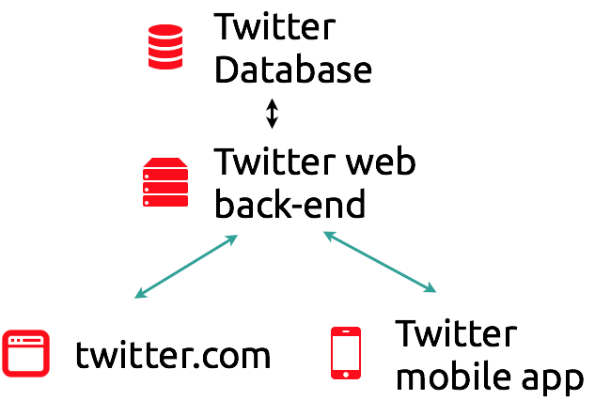
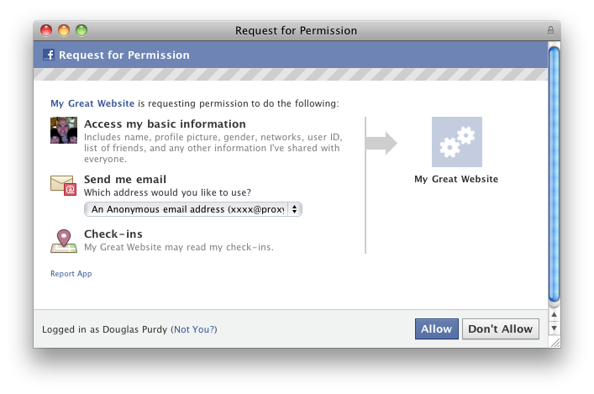
APIs & MVC in action
Available APIs:
Facebook
Twitter
Instagram
Foursquare
Marvel?
Chuck Norris?!
Talk Like a Pirate
openWeatherMap

Slide 38
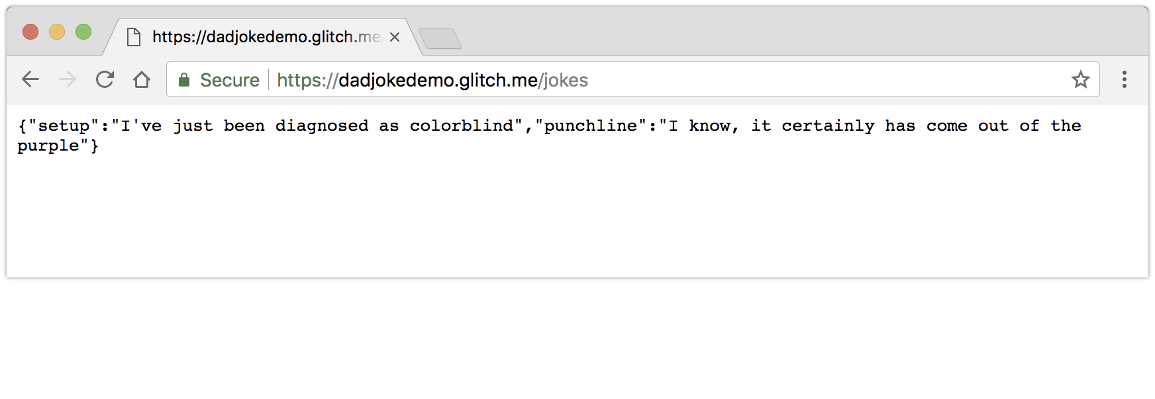
Dad Jokes API
What we just built, at /jokes, is an API for our dad jokes—a URL that computers can go to for a random joke

Slide 39
Dad Jokes App Spec
Delete every other file Glitch gives, except key.env, package.json, server.js
We’ll use URL/jokes as our “random joke API”
Create index.html, which has a button to press to get URL itself to retrieve a joke from our API, and client.js, which is the client-side JavaScript
Serve these two client files
If you think you can proceed from here, don’t go to the next slide! But see documentation of the following methods to be able to serve a HTML file:
jQuery.get()
res.sendFile()
Notes:
Challenge: solve this using Google/Stack Overflow/Documentation

Slide 40
App Architecture
Files to be downloaded by the client (Front End):
index.html
client.js (jQuery)
Files to be kept on your server hidden from client (Back End):
server.js (node)
You should be using node to run server.js, while client.js contains the jQuery code for manipulating your index.html

Slide 41
What goes in server.js?
In your server.js, add a “/” route to serve index.html:
app.route("/").get(function(req, res) {
res.sendFile("index.html", { root : __dirname});
});
Can you do the same to serve up app.js?
In other words, have the route /app.js give you the file app.js.

Slide 42
What goes in index.html?
Create the skeleton of a index.html page:
<button id="button">Press for joke</button>
<div id="setup">Setup goes here</div>
<div id="punchline">Punchline goes here</div>
Add a <script> include for jQuery (remember to change http to https if you’re using Glitch)
Add a <script> include for a file called client.js
See next slide for structure…

Slide 43
index.html (Outline)
<html>
<head>
Include jQuery
Include client.js
</head>
<body>
<h2>Dadjokes</h2>
Button with ID button (to get joke when clicked)
Div with ID setup (to display joke setup)
Div with ID punchline (to display joke punchline)
</body>
</html>
Notes:
Figure out the tags

Slide 44
What goes in client.js?
(Remember to do the jQuery include in your HTML)
$(function() {
$.get("/jokes",function(data){
alert(data.setup);
alert(data.punchline);
},"json");
});
This reads the API for the joke each time you load the page… and pops it up as an annoying alert, for testing

Slide 45
Make it so the button does it...
$(function() {
$("#button").click(function() {
$.get("/jokes",function(data){
alert(data.setup);
alert(data.punchline);
},"json");
});
});
Note: The data variable here is actually the object received from jokes[randomInteger]!
Almost as if
var data = jokes[randomInteger];
// data is a jokes object, i.e. data = {setup: “...”, punchline: “...”}
Notes:
Refer to slide previous few slides if you are still unsure of what is happening. Here the clicked button is actually REQuesting the server to GET /jokes, and expects the server to RESpond with an object, which is then assigned to the “data” variable inside the function. I promise this will make sense the more APIs you use.

Slide 46
What’s Happening?
Your Node app contains both client and server here:
Server: server.js (listening for people who type in URLs)
“When someone asks for the route /jokes, I’ll give them a joke in JSON format (an Object)”
“When someone asks for the route /, I’ll give them index.html”
“When someone asks for the route /app.js, I’ll give them app.js”
Client: index.html and client.js (run by the browser after it downloads the files from the server)
index.html: “When the browser loads this page, also load app.js”
app.js: “When the page is done loading, let’s go look up /jokes, grab the JSON joke, and put it back in the HTML page”

Slide 47
Exercise
Right now, your button alerts the setup and the punchline
We want to change the two DIVs to show the setup and punchline instead
Can you do that with jQuery?

Slide 48
Optimise 1: Static Assets
There are some items that are static — they don’t need to be served up separately
These are mostly client files, e.g. app.js, index.html, and maybe some CSS later on
Move them to a “static” folder, then ask Express to serve them directly:
app.use(express.static('static'));
Which lines can the above replace?
Refer to the original Glitch JS file for how this works
Notes:
This is handy when you have tons of files to serve up, and showcases some of the functionality express gives us.

Slide 49
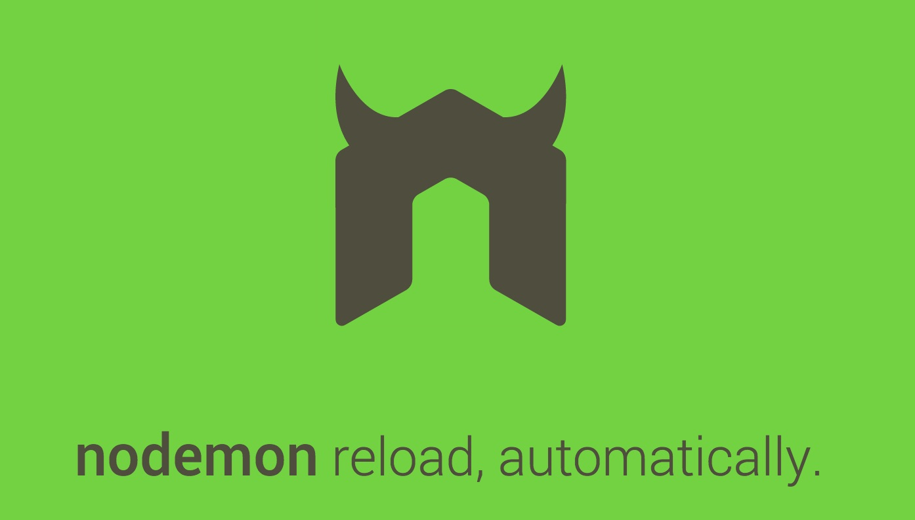
Optimise for local: Nodemon
No more Ctrl-C, up, enter! (needs admin access)
Notes:
npm install --save-dev nodemon
nodemon app.js

